Slide 1
Comparison Between Different Generations (1G,2G,3G,4G,5G)

Slide 2
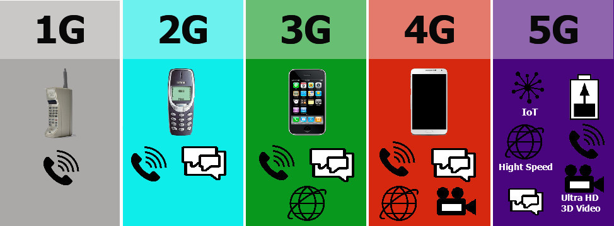

Slide 3
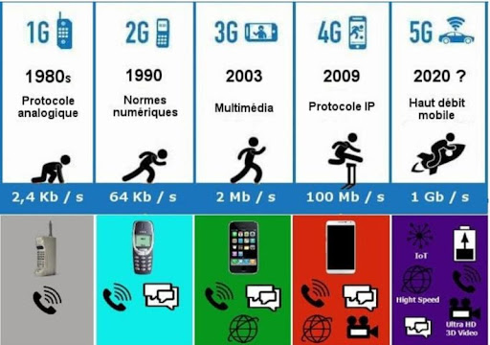

Slide 4
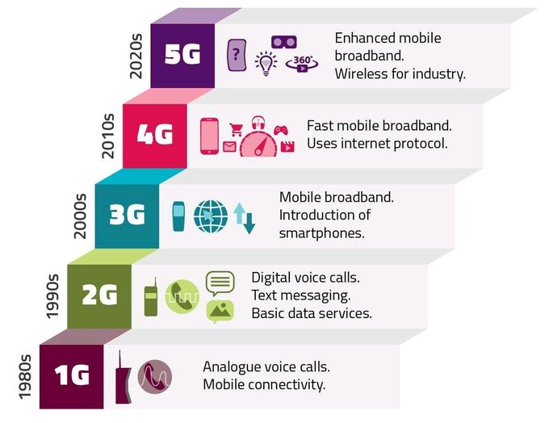

Slide 5
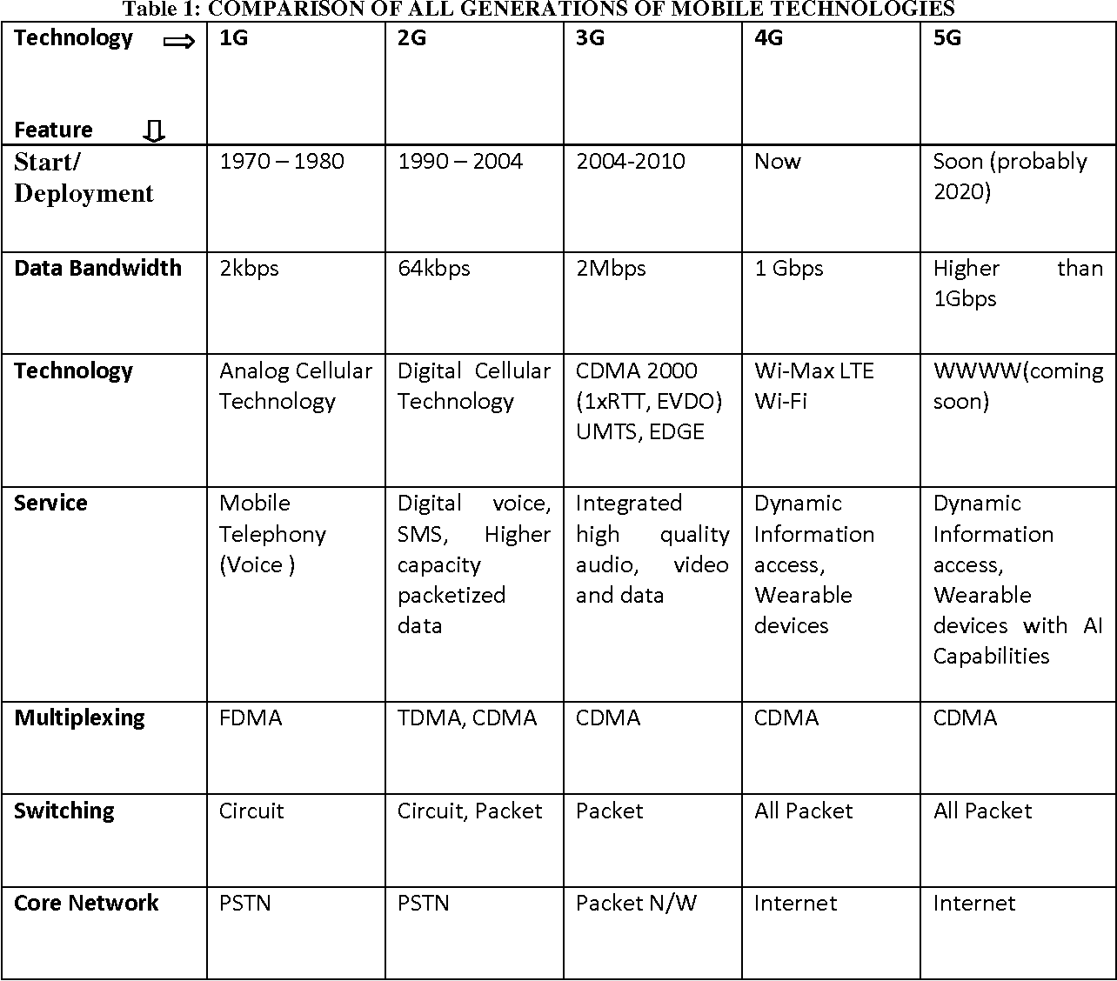
2010-2016

Slide 6
